Slide 1

Using the Advanced Search drop-down list operator "contains exact phrase starting with"
Yoel Kortick
Senior Librarian

Slide 2

Agenda
Introduction
Example 1
Example 2
Example 3

Slide 3
Introduction
For the following indexes an operator "Contains exact phrase starting with" exists:
Permanent Call Number (physical title)
LC Call Number (bibliographic)
Local call numbers (bibliographic)
The operator exists in the drop down list when searching via advanced search.

Slide 4
Introduction
In this presentation we will use examples to show how this operator works and how it differs from the "keywords" and "contains phrase" operators.
As we will see, the "Contains exact phrase starting with" is a much more precise method of searching that the keywords and phrase options. It allows for searching via special characters such as parentheses and periods.
It also allows for truncation in the sense that the beginning of a word can be searched for and all words beginning with that value will be retrieved.

Slide 5
Introduction
For more information regarding operator "Contains exact phrase starting with" see explanatory document "Using the Advanced Search drop-down list operator contains exact phrase starting with" at:
https://knowledge.exlibrisgroup.com/@api/deki/files/60407/Resource_Management_-_Using_the_Advanced_Search_drop-down_list_operator_contains_exact_phrase_starting_with.docx
See the On Line Help at:
https://knowledge.exlibrisgroup.com/Alma/Product_Documentation/Alma_Online_Help_(English)/Getting_Started/050Alma_User_Interface_%E2%80%93_General_Information/Searching_in_Alma

Slide 6
Agenda
Introduction
Example 1
Example 2
Example 3

Slide 7
Example 1
Record has permanent call number (520) BF277h
If we search for "Contains exact phrase starting with“ and value (520) then we find the record with permanent call number (520) BF277h
This is because when we search for "Contains exact phrase starting with" (520) then we find only records which start with (520) (including the parentheses).
If we search for either of the following:
  "Contains Phrase" (520)
  "Contains Keywords" (520)
then we find records which have 520 anywhere (not necessarily at the beginning of the field or word) and may or may not have parentheses. For example we will find records with
  call number (520) BF277h
  call number Texas. (Coast). Oil and Gas. 1:520,000. 1965. East sheet.
  call number M(520)49 100

Slide 8
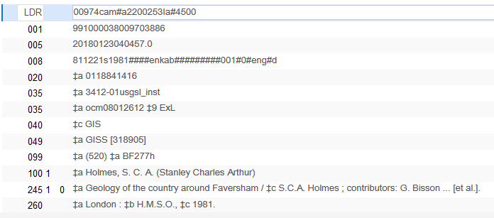
Example 1
Here is a record (991000038009703886) with local call number (520) BF277h
The title is "Geology of the country around Faversham"

Slide 9
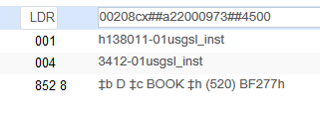
Example 1
The associated holdings record (22110658500003886 ) also has this call number (520) BF277h
Note that first indicator is an "8" meaning call number type "Other Scheme"

Slide 10
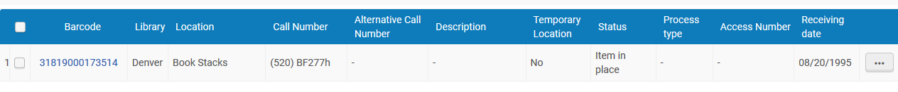
Example 1
The physical item (31819000173514) has inherited this call number:

Slide 11
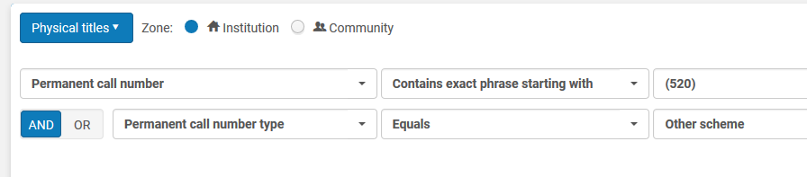
Example 1
Now we preform a search as follows:
Permanent call number Contains exact phrase starting with "(520)"
AND
Permanent call number type equals "Other scheme"

Slide 12
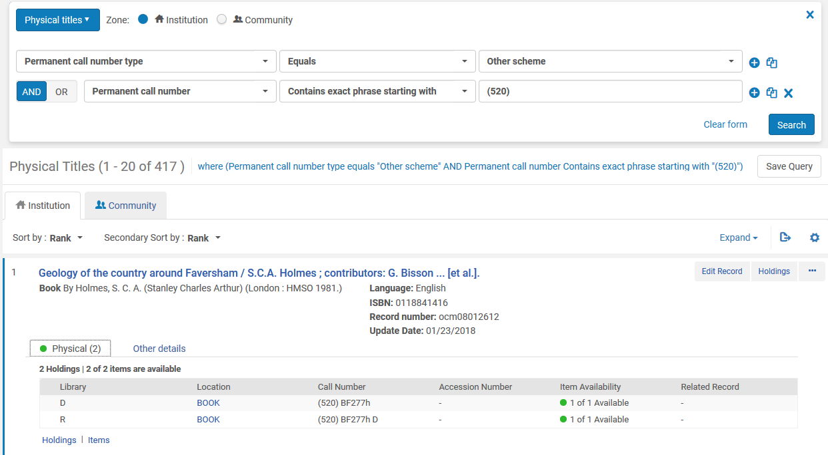
Example 1
We find exactly this record which has permanent call number starting with (520)

Slide 13
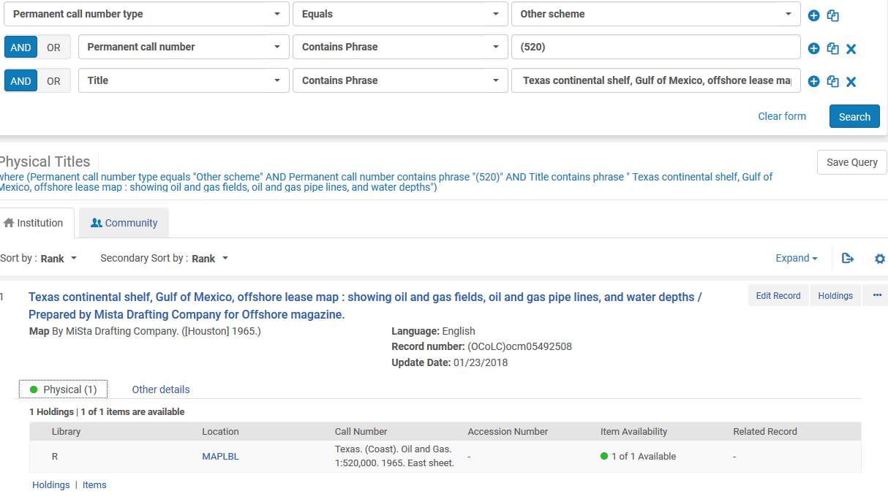
Example 1
If we had used "Contains Phrase" we would have found a lot more and it would not be values starting with (520) . They would have 520 anywhere and no parentheses
Here 520 has no parentheses and is between a colon and comma

Slide 14
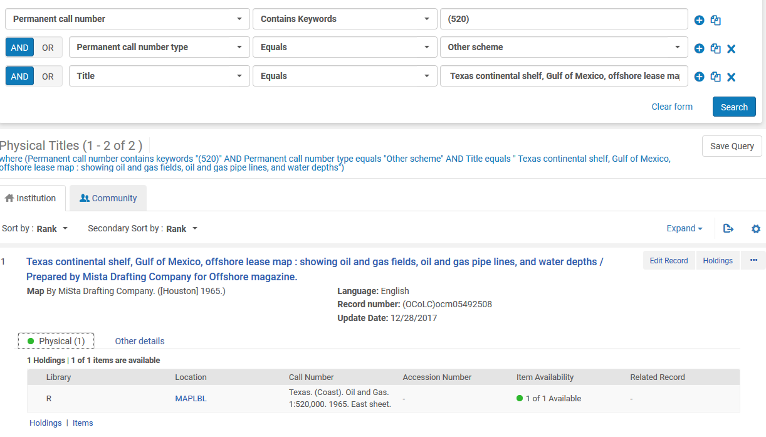
Example 1
If we had used "Contains Keywords" we would have found a lot more and it would not be values starting with (520) . They would have 520 anywhere and no parentheses
This is the same record we found with "contains phrase"

Slide 15
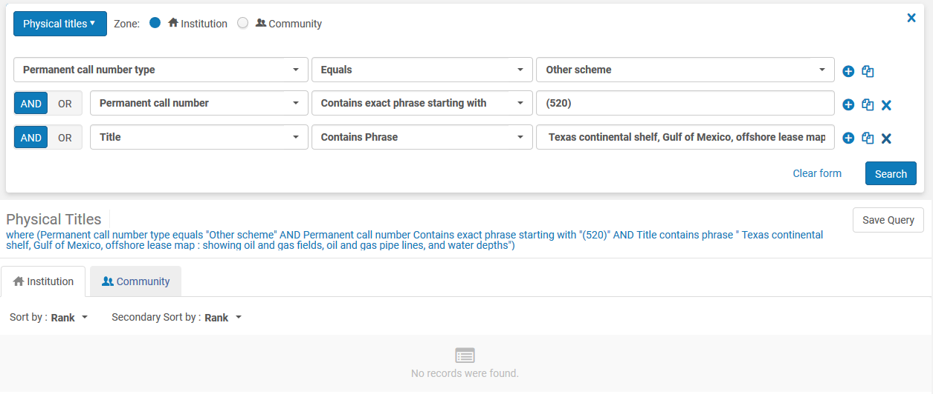
Example 1
The same search as we just did for "Contains Phrase" and "Contains Keywords" will find nothing if we change the operator to "Contains exact phrase starting with".
"Contains exact phrase starting with" (520) does not find "Texas. (Coast). Oil and Gas. 1:520,000. 1965. East sheet "

Slide 16
Agenda
Introduction
Example 1
Example 2
Example 3

Slide 17
Example 2
If we search for permanent call number "keywords contains" no.5 then we will find records with call number
  (267) K4mc no5 & no.8
    [there is no period between the "o" and the "5"]
  784 M755 no.5
    [there is a period between the "o" and the "5"]
If we search for permanent call number "contains exact phrase starting with" no.5 then we will find records with call number
  G(520) B77bg v.27 no.5
    [there is a space before "no.5" thus it is a new word]
  S(520) C23p no.52
    ["no.52" starts with "no.5"
"contains exact phrase starting with" does take into account special characters such as parentheses and period

Slide 18
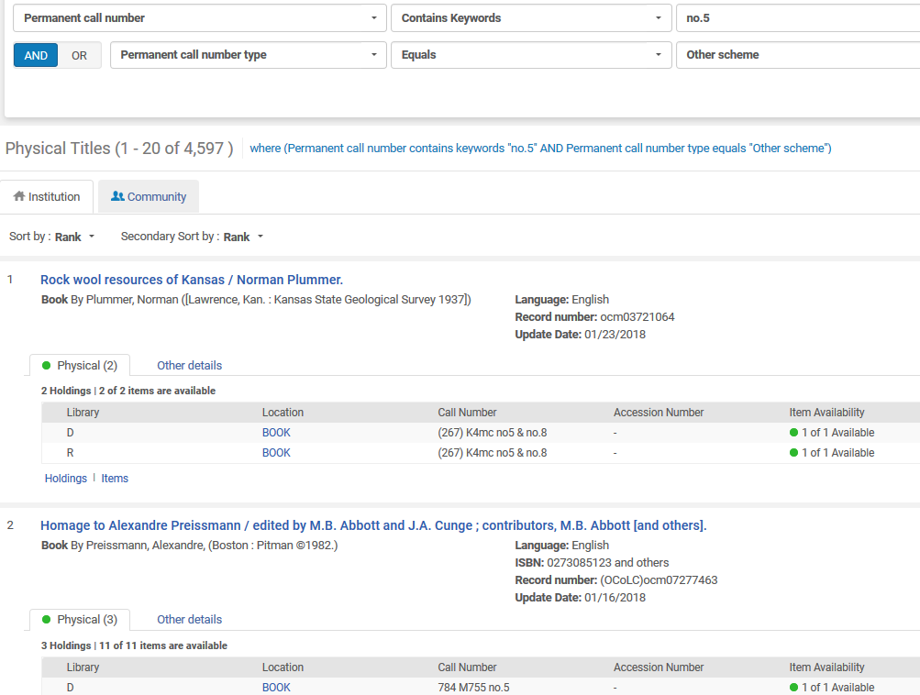
Example 2
Has period
"contains keywords" does NOT take into account special characters such as parentheses and period
No period
Has period

Slide 19
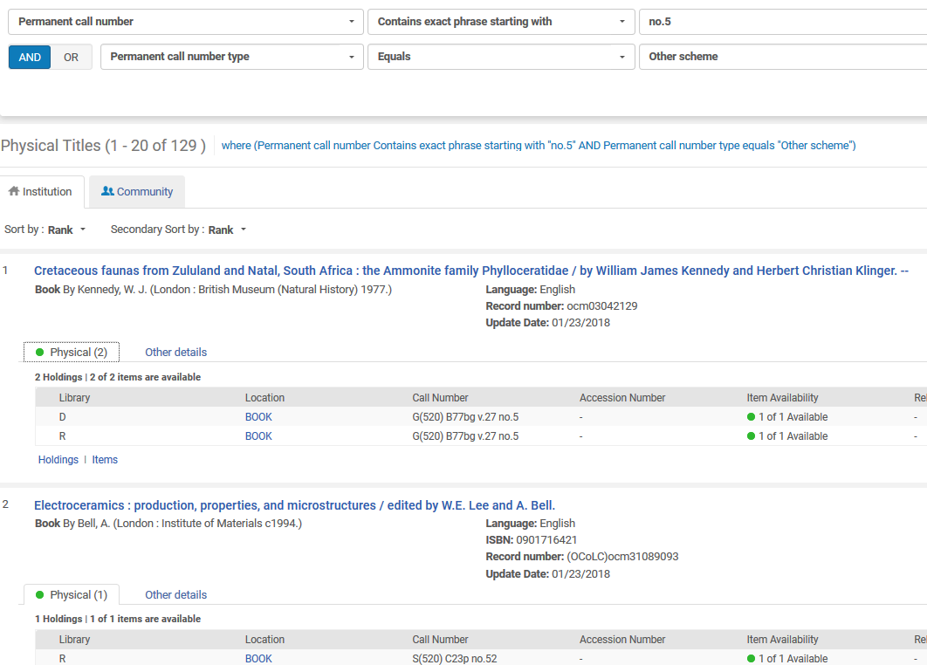
Example 2
Has period
"contains exact phrase starting with" DOES take into account special characters such as parentheses and period
Has period and full phrase "no.5"
Has period and full phrase starting with "no.5"

Slide 20
Agenda
Introduction
Example 1
Example 2
Example 3

Slide 21
Example 3
If we search for permanent call number "keywords contains" (52 then we will find records with call number word "52"
  S(530) B52ga Heft 52
  [The "(" we searched for is ignored]
If we search for permanent call number "contains exact phrase starting with" (52 then we will find records with call number
  (520) BF277h
    [It starts with (52. The "(" we searched for is not ignored]
  (521) G743c 2017
    [It starts with (52. The "(" we searched for is not ignored]

Slide 22
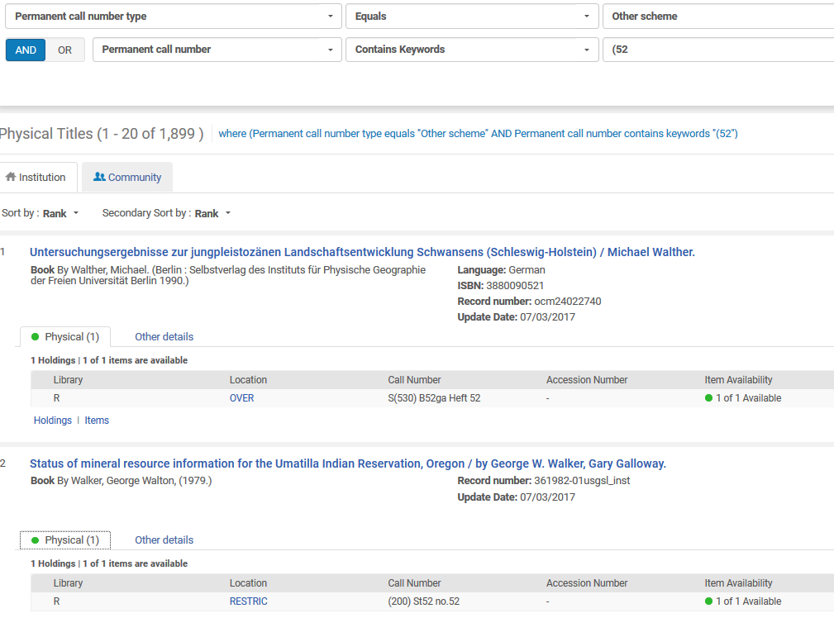
Example 3
The ( is ignored

Slide 23
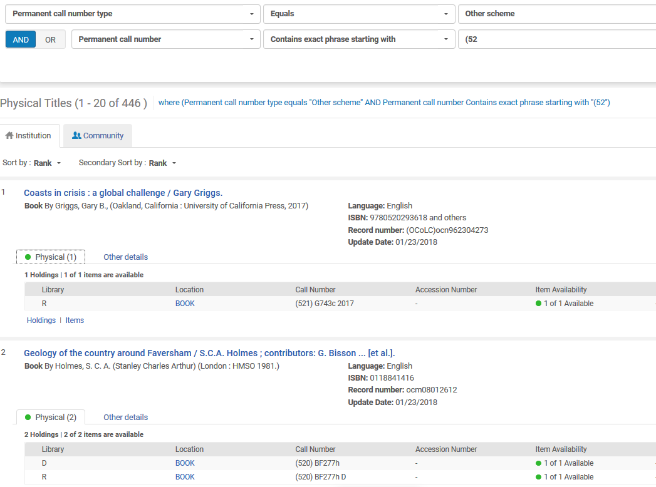
Example 3
Search for "(52"
Retrieve "(520)" and also retrieve "(521)"

Slide 24


THANK YOU

